Slide 1

Presented By:
Group: Hackathon Geeks
Pooja Agrawal
Babitha Reddy
Balaji Gannavarapu
Sathyadhari Yenugu

Slide 2
Project Problem Statement
Ericsson requires a web view where they can do maintenance and housekeeping several network monitoring tools running in their office environment. For each tool they have 3 entities: Elements, KeyPerformanceIndicators and Schedule.
As per requirement, the user should be able to add, edit or disable particular entity.
Also they need a Web View where user can pass current time and it would return KPI values for elements by looking at 3 entities and a history module through which the user can view the previous updates details.
Our Solution
As per our solution we created a dashboard with 6 modules as follows:
Tool Management
Element Management
KPI Management
Schedule Management
History Management
Current Time KPI
In all these modules, user is able to view, add, edit and disable the particular entity according to his/her choice. In History module, a user is able to view the previous 10 updates details like Updated time, Updated By. In Current Time KPI module, user can pass current time and it would return KPI values for elements by looking at 3 entities.

Slide 3
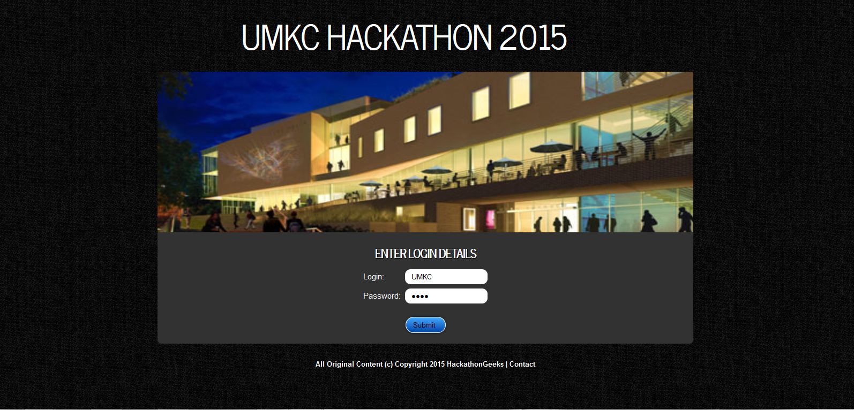
LOGIN PAGE

Slide 4
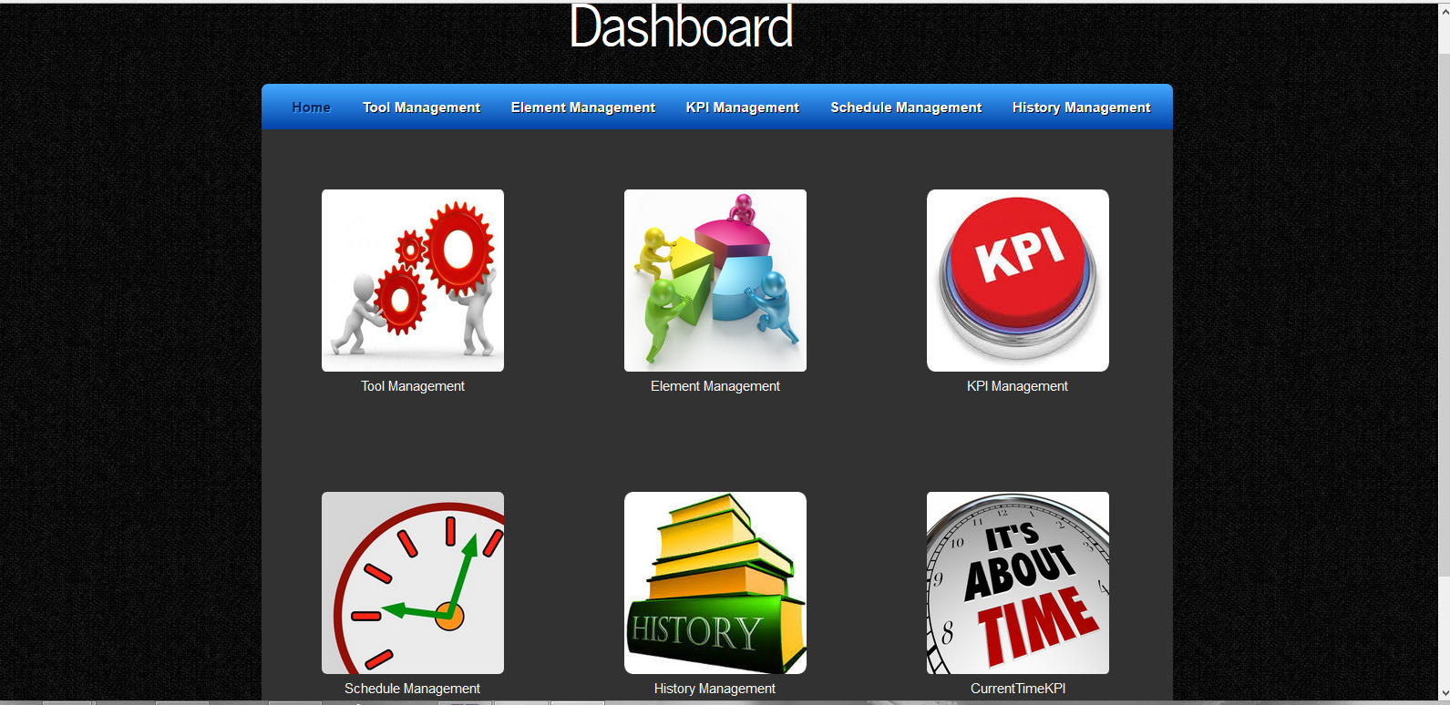
DASHBOARD

Slide 5
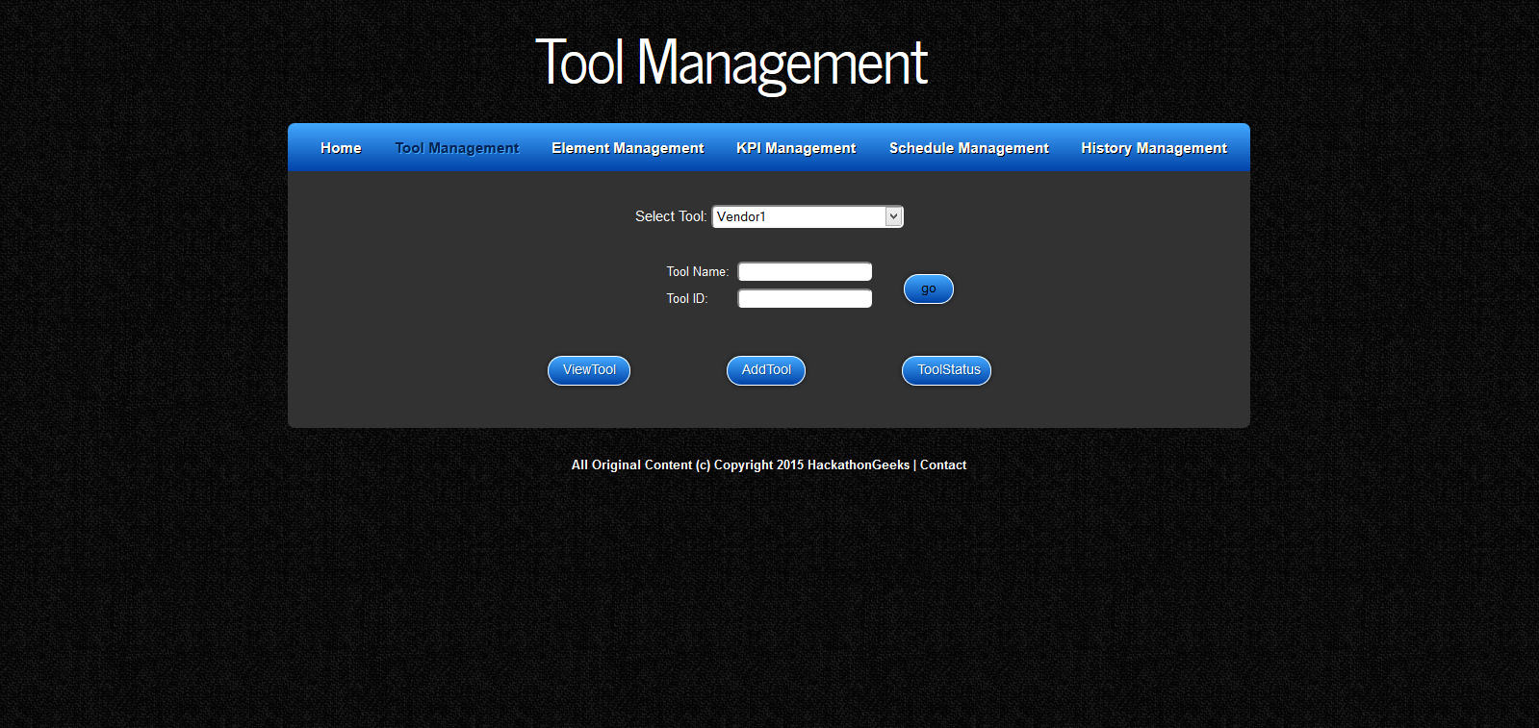
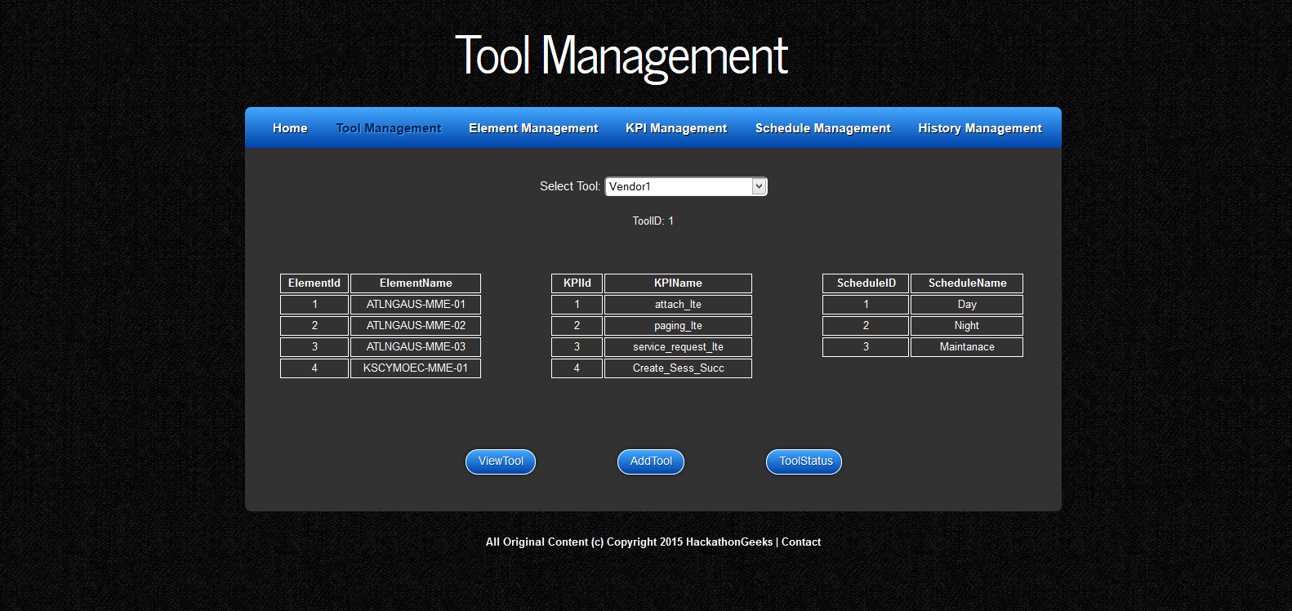
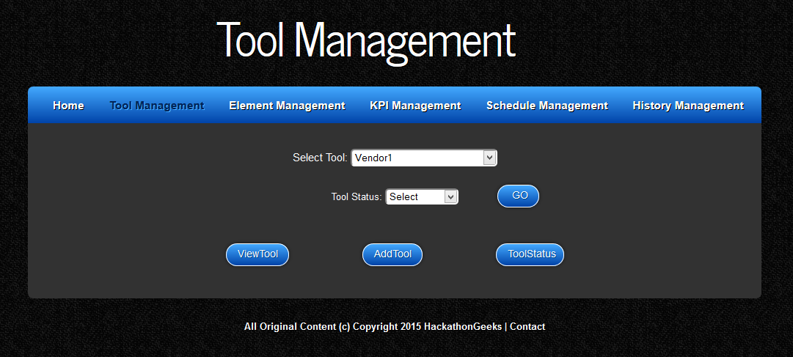
TOOL MANAGEMENT

Slide 6
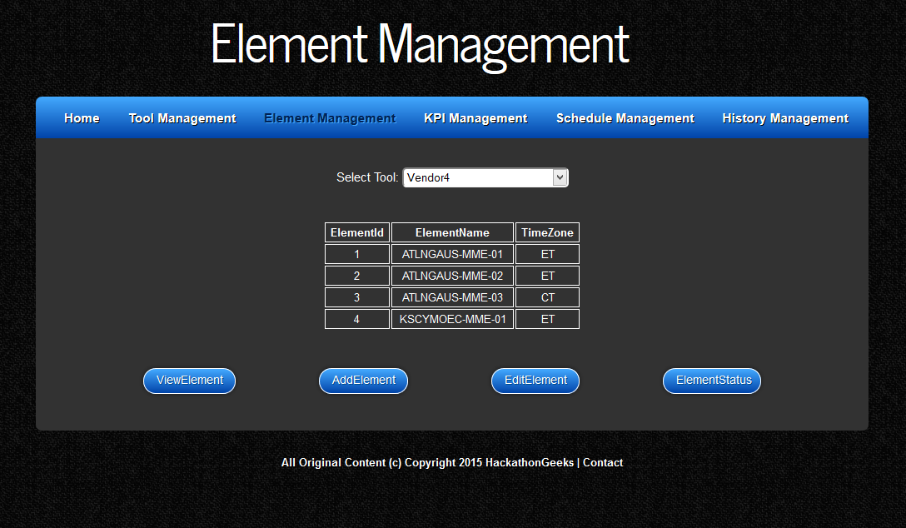
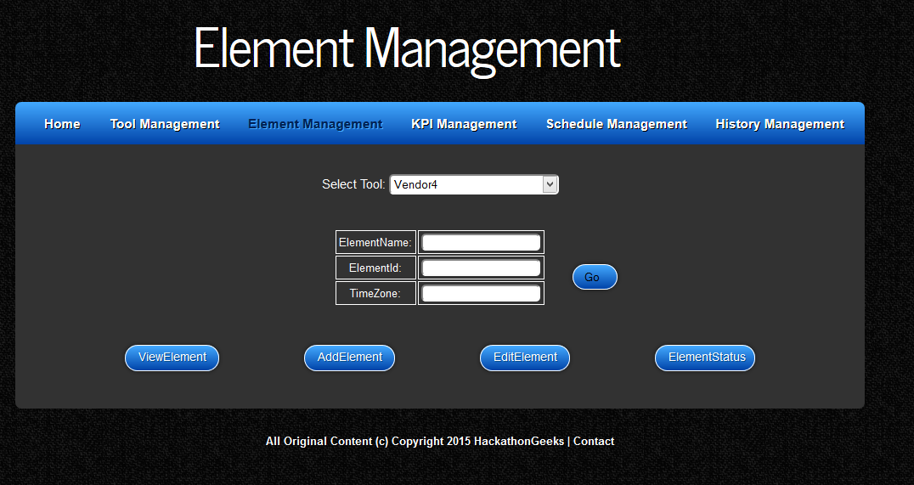
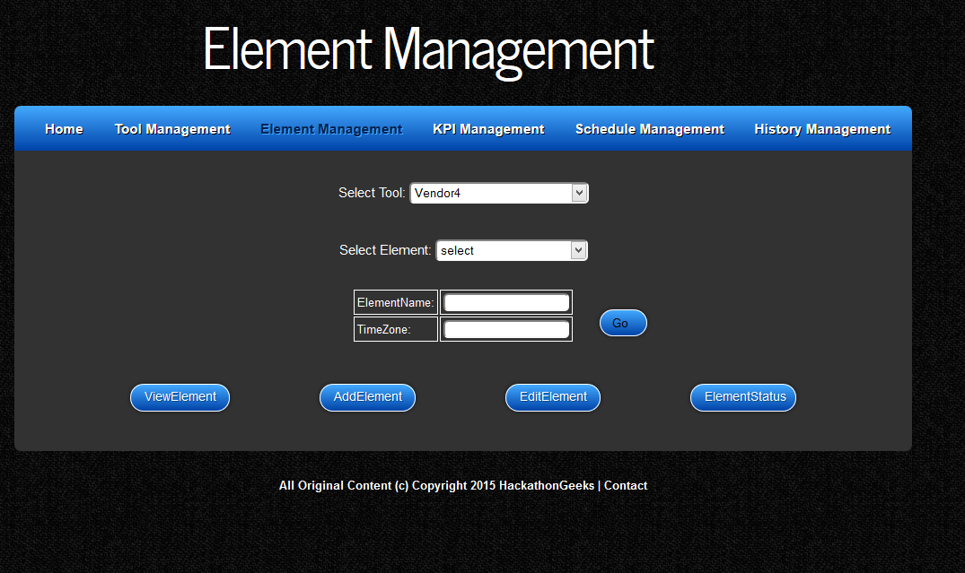
ELEMENT MANAGEMENT

Slide 7
KPI MANAGEMENT

Slide 8
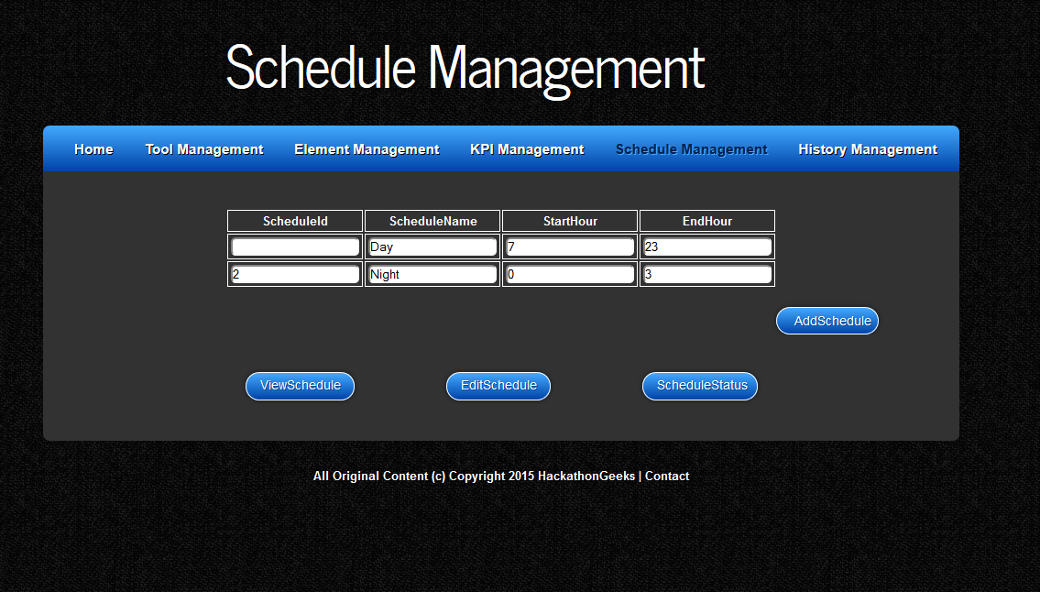
SCHEDULE MANAGEMENT

Slide 9
HISTORY MANAGEMENT

Slide 10
CURRENT TIME KPI

Slide 11
REFERENCES

Slide 12


